Slide 1
FINITE ELEMENT ANALYSIS OF THREE FLUID HEAT EXCHANGER
Name of the Guide: Mr. Vijaykumar V M
Assistant Professor
Department of Mechanical Engineering
Bangalore Institute of Technology, Bengaluru.
GROUP MEMBERS
PRAMOD S 1BI13ME077
RAHUL J BALIGA 1BI13ME084
THUSHAR C 1BI13ME108
VINEETH N VISHWAMITHRA 1BI13ME119

Slide 2
LITERATURE
FINITE ELEMENT METHOD FOR HEAT EXCHANGERS BY Dr. K N SEETHARAMU – Finite
Element analysis of two fluid heat exchangers. This compares the results of FEM with the analytical method and number of elements required for the convergence of solutions is found for both parallel and counter flow heat exchangers.
FINITE ELEMENT ANALYSIS FOR CO-CURRENT AND COUNTER-CURRENT PARALLEL FLOW THREE-FLUID HEAT EXCHANGER - Nawaf H. Saeid Department of Mechanical Engineering, Curtin University of Technology, Miri, Malaysia, and K.N. Seetharamu M S Ramaih School of Advanced Studies, Bangalore, India – This compares the results of the Subdomain collocation method and the Galerkin’s method and it is found that Sub-domain collocation method is more accurate.
ANALYTICAL SOLUTIONS FOR THE EQUATIONS FOR THE TRANSIENT TEMPERATURE FIELD IN THE THREE FLUID PARALLEL CHANNEL HEAT EXCHANGER WITH THREE THERMAL COMMUNICATIONS – Leszek Malinowski and Jian Hua Chen.
This paper evaluated the parameters for the turbulent transient flow. This was considered as a reference for steady state laminar flow calculation.

Slide 3
PROBLEM DEFINITION
From the literature survey, we found that three fluid heat exchangers are more useful when compared to two fluid heat exchangers because the have more effectiveness .
There is no proper analytical method to easily find the various parameters of the three fluid heat exchangers.
This problem can be taken up in Finite element methods and solved with the same principle as that of two fluid heat exchangers.

Slide 4
OBJECTIVES
Modeling of the three-fluid heat exchangers, with main focus to find the thermal fields in the heat exchangers using finite element analysis to find various parameters such as output temperatures and effectiveness.
Solving the same problem using MATLAB by executing the programs which are encoded based on the derivations and formulas as required.
Comparing the solutions obtained by both the analytical method and that of obtained by the software and also comparing the results of three fluid(also multifluid) with commonly used two fluid heat exchangers.

Slide 5
METHODOLOGY
Finite element modeling of three fluid heat exchangers using sub domain collocation and Galerkin's method.
Construction of stiffness matrix for the system.
Evaluation of the unknowns using characteristic equation. Manual calculations for two element discretized heat exchanger.
Coding the finite element analysis for general case of 'n' element discretized heat exchanger in MATLAB. Also to find the optimum number of elements required for convergence of solution.

Slide 6
Phase I
Introduction to Heat Exchangers and different types of heat exchangers .
Effectiveness of heat exchangers.
Analysis of heat exchangers:
1. LMTD method 2.NTU method
Phase II
Finite element analysis of two and three fluid heat exchangers .
MATLAB codes of Sub-Domain Collocation and Galerkin method for two-fluid parallel and counter flow arrangement heat exchanger.
Phase III
Matlab coding for finite element analysis of three fluid heat exchangers
Tabulation of results of effectiveness for different number of elements at different NTU values.
Generation of plots of effectiveness vs number of elements to visualize the convergence of solution of analytical method with Finite Element method.

Slide 7
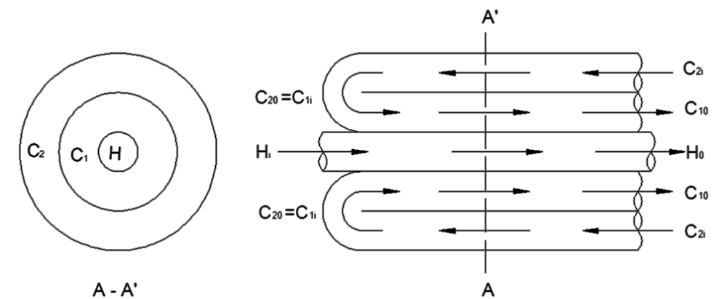
HEAT EXCHANGERS
Heat Exchangers are thermal devices that transfer or exchange heat from one fluid stream to one or more other fluid streams which are at different temperatures.
CLASSIFICATION OF HEAT EXCHANGERS
1. BASED ON THE SURFACE COMPACTNESS
2. BASED ON NUMBER OF FLUIDS

Slide 8
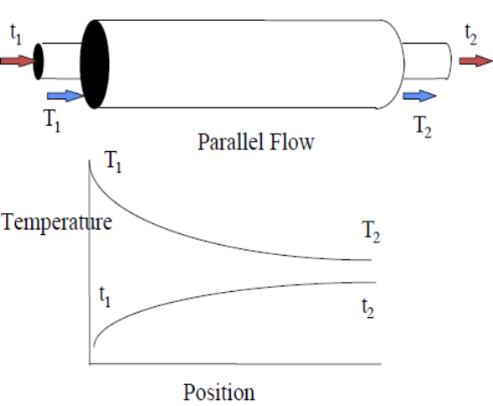
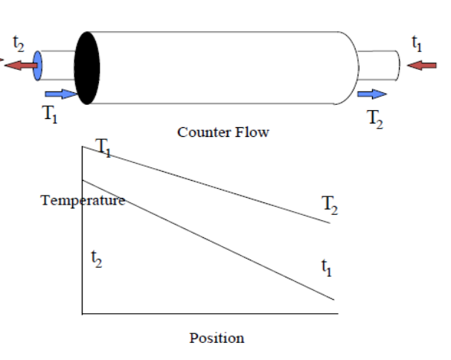
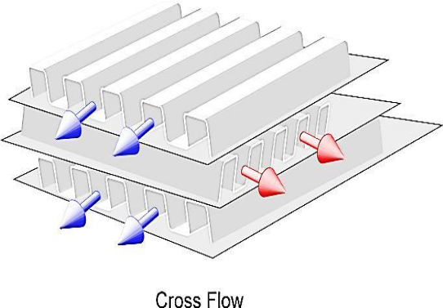
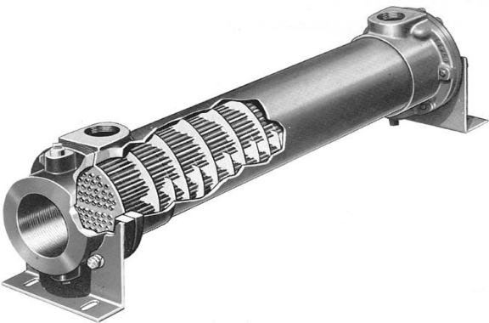
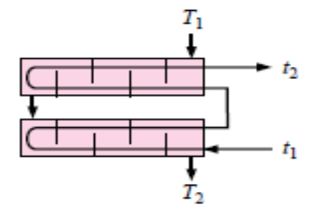
3. ACCORDING TO RELATIVE DIRECTION OF FLUID FLOW
4. BASED ON DESIGN AND CONSTRUCTIONAL FEATURES

Slide 9
ANALYSIS OF HEAT EXCHANGERS
Analysis of a heat exchanger involves determining the inlet and outlet temperatures of the fluids, heat exchange between the fluids, effectiveness of heat exchanger for the given type of heat exchanger.
There are two methods used in the analysis of Heat Exchangers
1. Logarithmic Mean Temperature Difference
2. Effectiveness – NTU method

Slide 10
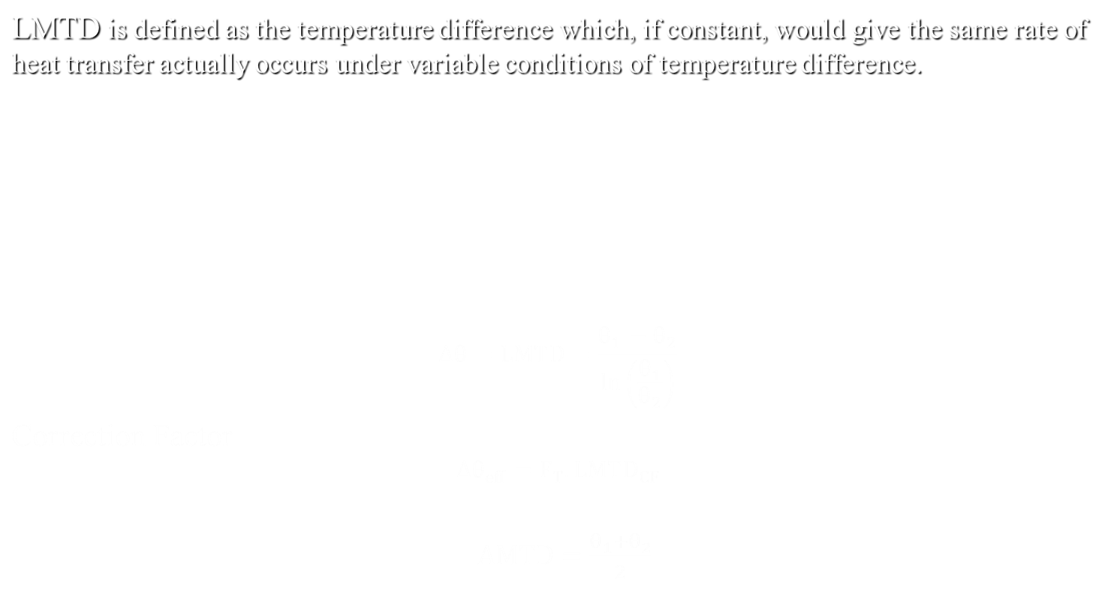
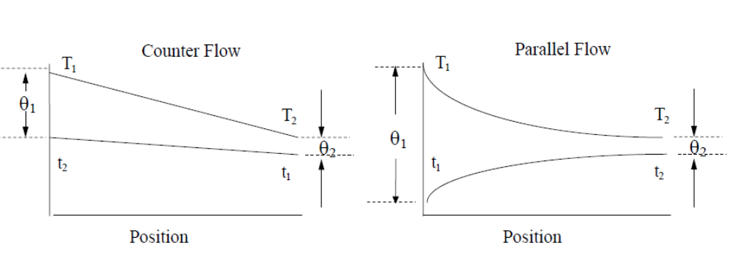

Slide 11
EFFECTIVENESS OF HEAT EXCHANGER
The effectiveness of a heat exchanger is defined as a ratio of actual rate of heat transfer to the maximum possible rate of heat transfer.
ϵ = (Actual rate of heat transfer)/(Maximum heat transfer)
The actual rate of heat transfer is the heat lost by the hot fluid or heat gained by the cold fluid.
q_{max} = C_{min} ( T_{hi} - T_{ci} )
q_{actual} = C_{h} ( T_{hi} - T_{ho} ) = C_{c} ( T_{co} - T_{ci} )
Effectiveness by definition is, ϵ = q_{actual} /q_{max}
ϵ = ( T_{hi} - T_{ho} ) / ( T_{hi} - T_{ci} ) when C_{h} < C_{c} i.e., C_{h} = C_{min}
ϵ = ( T_{co} - T_{ci} ) / ( T_{hi} - T_{ci} ) when C_{c} < C_{h} i.e., C_{c} = C_{min}

Slide 12
EFFECTIVENESS – NTU METHOD
Variables in NTU method
1. C = C_{min} /C_{max}
2. NTU = UA/ C_{min}
Parallel Flow Heat Exchanger
ϵ = (1 – e ^{–NTU(1+R)} )/ (1+ R)
Counter Flow Heat Exchanger
ϵ = (1 – e ^{–NTU(1-R)} )/ (1 – R*e ^{–NTU(1-R)} )

Slide 13
INTRODUCTION TO FINITE ELEMENT ANALYSIS
The finite element method (FEM) is a numerical method for solving problems of engineering and mathematical physics . It is also referred to as finite element analysis (FEA).
Typical problem areas of interest include structural analysis, heat transfer, fluid flow etc.
The finite element method formulation of the problem results in a system of algebraic equations. The method yields approximate values of the unknowns at discrete number of points over the domain.
To solve the problem, it subdivides a large problem into smaller, simpler parts that are called finite elements. The simple equations that model these finite elements are then assembled into a larger system of equations that models the entire problem

Slide 14
BASIC STEPS IN FINITE ELEMENT METHOD
Discretization of the continuum.
Selection of approximating function.
Formulation of elemental stiffness matrix.
Formation of overall stiffness matrix.
Formulating of element loading matrix.
Formulation of overall loading matrix.
Formulation of overall equilibrium equation.
Incorporation of boundary conditions.
Calculation of unknown temperatures.

Slide 15
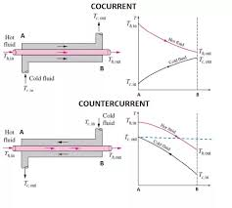
FINITE ELEMENT FORMULATION OF TWO FLUID HEAT EXCHANGER
Consider the flow arrangement and temperature profile diagram of a two fluid parallel flow and counter flow heat exchanger

Slide 16
ELEMENTAL STIFFNESS MATRIX
The matrix is obtained as follows for parallel flow
k= a-0.5 -a a/2+0.5 -a/2
-b b-0.5 -b/2 b/2+0.5
a/2-0.5 -a/2 a+0.5 -a
-b/2 b/2-0.5 -b b+0.5
The matrix is obtained as follows for counter flow
k= a-0.5 -a a/2+0.5 -a/2
b -b-0.5 b/2 -b/2+0.5
a/2-0.5 -a/2 a+0.5 -a
b/2 -b/2-0.5 b -b+0.5
where a=NTUe/3; b=NTUe*R/3

Slide 17
RESULT TABLES
Two-Fluid Parallel Flow: Galerkin’s Method
Number of elements
NTU | ANALYTICAL VALUE | 1 | 2 | 4 | 8 | 16 | 32 | 64
0.5 | 0.3518 | 0.3333 | 0.3495 | 0.3512 | 0.3516 | 0.3517 | 0.3517 | 0.3518
1 | 0.5179 | 0.5000 | 0.5128 | 0.5165 | 0.5175 | 0.5178 | 0.5179 | 0.5179
1.5 | 0.5964 | 0.5900 | 0.5919 | 0.5948 | 0.5960 | 0.5963 | 0.5964 | 0.5964
2 | 0.6335 | 0.6267 | 0.6316 | 0.6322 | 0.6331 | 0.6334 | 0.6335 | 0.6335
2.5 | 0.6510 | 0.6488 | 0.65 | 0.6502 | 0.6507 | 0.6509 | 0.6510 | 0.6510
3 | 0.6593 | 0.657 | 0.6581 | 0.6589 | 0.6591 | 0.6592 | 0.6592 | 0.6593

Slide 18
Two-Fluid Parallel Flow: Sub-domain collocation Method
NTU | AE | 1 | 2 | 4 | 8 | 16 | 32 | 64
0.5 | 0.3518 | 0.3636 | 0.3546 | 0.3525 | 0.3519 | 0.3518 | 0.3518 | 0.3518
1 | 0.5179 | 0.5714 | 0.5289 | 0.5206 | 0.5186 | 0.5181 | 0.518 | 0.5179
1.5 | 0.5964 | 0.7059 | 0.6144 | 0.6006 | 0.5974 | 0.5967 | 0.5965 | 0.5964
2 | 0.6335 | 0.8 | 0.6531 | 0.6382 | 0.6346 | 0.6338 | 0.6335 | 0.6335
2.5 | 0.6510 | 0.8696 | 0.6660 | 0.6553 | 0.6521 | 0.6513 | 0.6511 | 0.6510
3 | 0.6593 | 0.9231 | 0.6644 | 0.6626 | 0.6601 | 0.6593 | 0.6593 | 0.6593

Slide 19
Two-Fluid Counter Flow: Galerkin's Method
NTU | Analytical value | 1 | 2 | 4 | 8 | 16 | 32 | 64
0.5 | 0.3623 | 0.3529 | 0.3619 | 0.3622 | 0.3622 | 0.3623 | 0.3623 | 0.3623
1 | 0.5647 | 0.5455 | 0.5632 | 0.5643 | 0.5646 | 0.5647 | 0.5647 | 0.5647
1.5 | 0.6908 | 0.6667 | 0.6879 | 0.6900 | 0.6906 | 0.6907 | 0.6908 | 0.6908
2 | 0.7746 | 0.7500 | 0.7706 | 0.7736 | 0.7743 | 0.7745 | 0.7746 | 0.7746
2.5 | 0.8328 | 0.8108 | 0.8282 | 0.8315 | 0.8325 | 0.8327 | 0.8328 | 0.8328
3 | 0.8744 | 0.8571 | 0.8696 | 0.8731 | 0.8741 | 0.8743 | 0.8744 | 0.8744

Slide 20
Two-Fluid Counter Flow: Sub-domain collocation Method
Two Fluid Counter Flow Subdomain
NTU | AE | 1 | 2 | 4 | 8 | 16 | 32 | 64
0.5 | 0.36227 | 0.36364 | 0.36261 | 0.36235 | 0.36229 | 0.36227 | 0.36227 | 0.36227
1.0 | 0.56473 | 0.57143 | 0.56637 | 0.56514 | 0.56484 | 0.56476 | 0.56474 | 0.56473
1.5 | 0.69079 | 0.70588 | 0.69439 | 0.69168 | 0.69101 | 0.69084 | 0.69080 | 0.69079
2.0 | 0.77460 | 0.80000 | 0.78049 | 0.77605 | 0.77496 | 0.77469 | 0.77462 | 0.77461
2.5 | 0.83280 | 0.86957 | 0.84100 | 0.83480 | 0.83329 | 0.83292 | 0.83283 | 0.83280
3.0 | 0.87443 | 0.92308 | 0.88479 | 0.87694 | 0.87505 | 0.87458 | 0.87446 | 0.87443

Slide 21
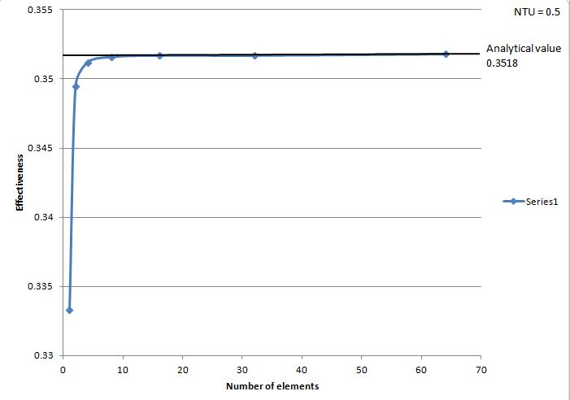
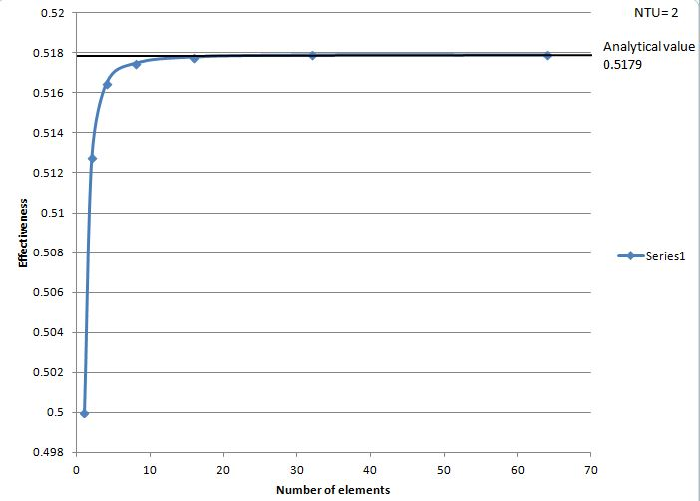
EFFECTIVENESS vs NUMBER OF ELEMENTS PLOT FOR DIFFERENT NTU VALUES
Parallel Flow
NTU=1

Slide 22
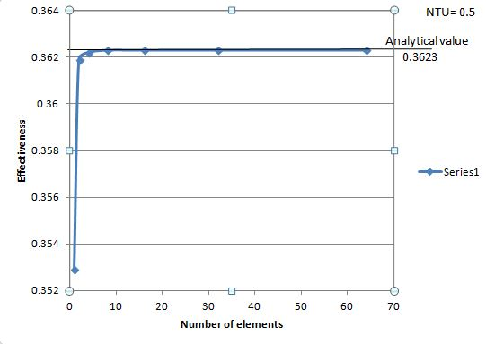
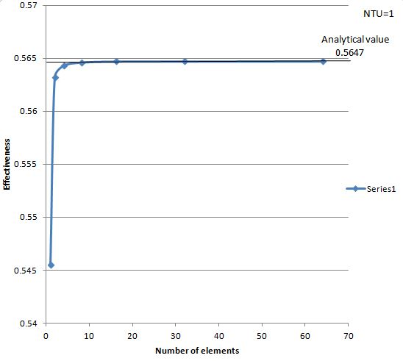
EFFECTIVENESS vs NUMBER OF ELEMENTS PLOT FOR DIFFERENT NTU VALUES
Counter Flow

Slide 23
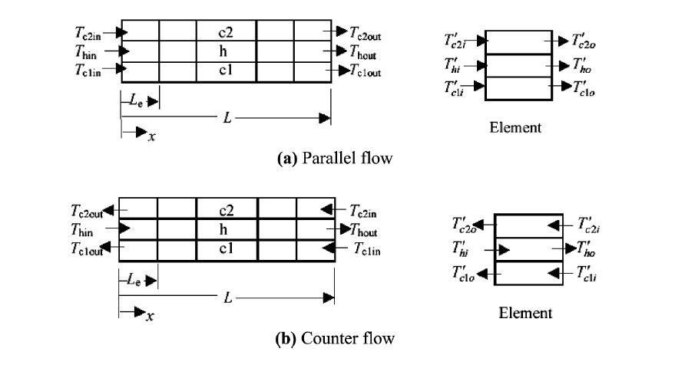
THREE FLUID PARALLEL AND COUNTER ARRANGEMENT

Slide 24
FINITE ELEMENT ANALYSIS OF THREE FLUID HEAT EXCHANGER
Consider the steady-state flow of the hot fluid in the middle channel between two steady-state parallel flows or two counter flow cold fluids as shown.
The boundary conditions are given by specifying the inlet temperatures of the three streams. To generalize the formulations it is assumed that the overall heat transfer coefficient U between the hot fluid and the two cold fluids are different.
Variable contact areas between the hot channel and the two cold fluids are assumed. Applying the conservation of energy principle for each of the three streams the following equations are derived.

Slide 25
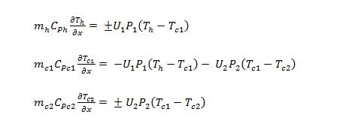

where the positive sign in equations is for parallel flow and the negative sign is for the counter flow, U₁ and U₂ are the overall heat transfer coefficients between the hot fluid and cold fluid c1 and cold fluid c2 respectively. P₁ and P₂ are the contact perimeters of hot channel with cold channels c1 and c2 respectively. In order to simplify and generalize the equations, the following dimensionless variables are introduced:

Slide 26
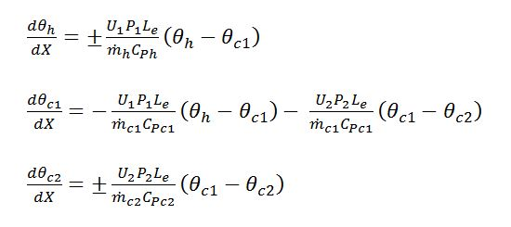
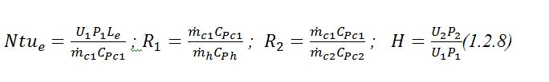
Where L_{e} is the length of the element and the inlet temperatures of the two cold streams need not be equal. It can be shown that the dimensionless forms of the governing equations are:
The governing parameters can be combined together in order to reduce the number of the parameters as follows:

Slide 27
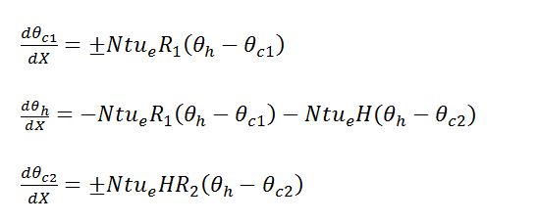
Therefore, the final forms of the dimensionless governing equations are :
Equations above should be solved with the specified inlet temperatures to find the outlet temperatures from each channel. Therefore the dimensionless boundary conditions can be defined as: θ_{hin} = 1, θ_{c1in} =0 and θ_{c2in} = 0 .

Slide 28
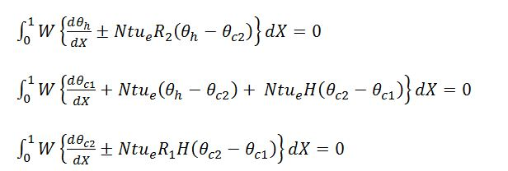
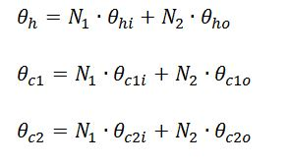
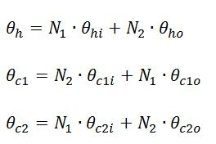
SUBDOMAIN COLLOCATION METHOD
Assuming a linear variation of the hot and cold fluids in a single element
For the parallel flow as: For the counter flow as:
2
1

Slide 29
Substitution of these approximations in equations the set of three algebraic equations can be obtained where the weighted parameter W is taken to be unity.
If the number of elements is more than one, care should be taken in assigning correct boundary conditions, where in these cases the outlet temperature from one element is equal to the inlet temperature to the next element in the direction of the fluid flow.
Therefore the discretized governing equations can be written in matrix form for each element as:
[K]{θ} = {f }
where [K] is known as the stiffness matrix and it is (6×6) matrix for each element.

Slide 30
ELEMENTAL STIFFNESS MATRIX
The matrix is obtained as follows for parallel flow
K= -0.5+a+c -a -c 0.5+a/2+c/2 -a/2 -c/2
-b -0.5+b 0 -b/2 0.5+b/2 0
-d 0 -0.5+d -d/2 0 0.5+d/2
-0.5+a/2+c/2 -a/2 -c/2 0.5+a+c -a -c/2
-b/2 -0.5+b/2 0 -b 0.5+b 0
-d/2 0 -0.5+d/2 -d 0 0.5+d
Where a=NTUe/3
b=NTUe*R1/3
c=a*h
d=a*R2*h

Slide 31
The matrix is obtained as follows for counter flow
K= -0.5+a+c -a -c 0.5+a/2+c/2 -a/2 -c/2
b -0.5-b 0 b/2 0.5-b/2 0
d 0 -0.5-d d/2 0 0.5-d/2
-0.5+a/2+c/2 -a/2 -c/2 0.5+a+c -a -c/2
b/2 -0.5-b/2 0 b 0.5-b 0
d/2 0 -0.5-d/2 d 0 0.5-d
Where a=NTUe/3
b=NTUe*R1/3
c=a*h
d=a*R2*h

Slide 32
RESULTS
NUMBER OF ELEMENTS
NTU | 2E | 8E | 16E | 32E | 64E | 128E | 256E | 512E | 1024E
0.5 | 0.5268 | 0.5283 | 0.5281 | 0.528 | 0.5279 | 0.5279 | 0.5279 | 0.5279 | 0.5279
1 | 0.664 | 0.6577 | 0.6568 | 0.6563 | 0.6560 | 0.6559 | 0.6558 | 0.6558 | 0.6558
1.5 | 0.7088 | 0.6953 | 0.6935 | 0.6926 | 0.6921 | 0.6919 | 0.6918 | 0.6917 | 0.6917
2 | 0.7266 | 0.7113 | 0.7088 | 0.7075 | 0.7069 | 0.7066 | 0.7065 | 0.7064 | 0.7064
2.5 | 0.7353 | 0.7221 | 0.7190 | 0.7174 | 0.7167 | 0.7163 | 0.7161 | 0.7160 | 0.7160
3 | 0.7407 | 0.7316 | 0.7278 | 0.7260 | 0.7250 | 0.7246 | 0.7244 | 0.7243 | 0.7242

Slide 33
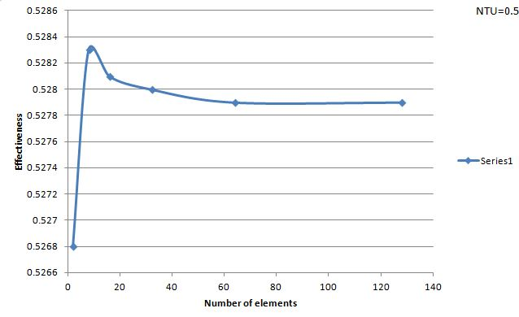
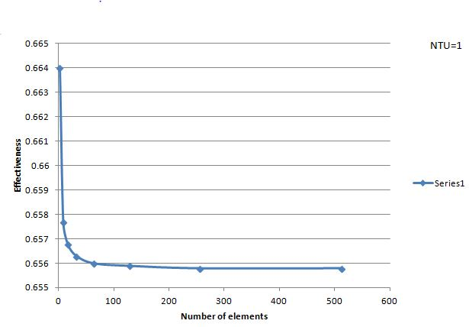
PLOTS- EFFECTIVENESS vs NUMBER OF ELEMENTS

Slide 34
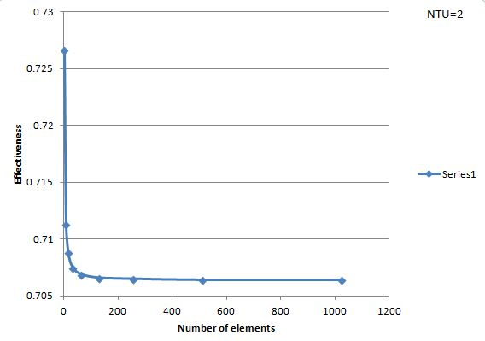
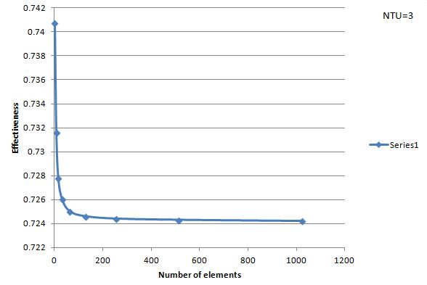

Slide 35
RESULTS
NUMBER OF ELEMENTS
NTU | 2E | 4E | 8E | 16E | 32E | 64E | 128E
0.5 | 0.5682 | 0.5703 | 0.5709 | 0.5710 | 0.5710 | 0.5711 | 0.5711
1 | 0.7778 | 0.7831 | 0.7846 | 0.7849 | 0.7850 | 0.7851 | 0.7851
1.5 | 0.8763 | 0.8829 | 0.8848 | 0.8853 | 0.8854 | 0.8855 | 0.8855
2 | 0.9286 | 0.9345 | 0.9365 | 0.9371 | 0.9372 | 0.9372 | 0.9372
2.5 | 0.9583 | 0.9627 | 0.9645 | 0.9649 | 0.9651 | 0.9651 | 0.9651
3 | 0.9759 | 0.9785 | 0.9799 | 0.9803 | 0.9804 | 0.9805 | 0.9805

Slide 36
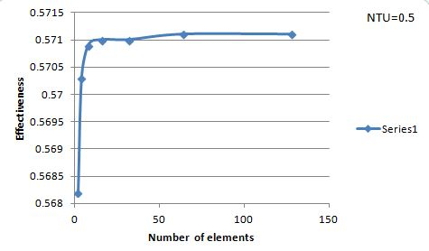
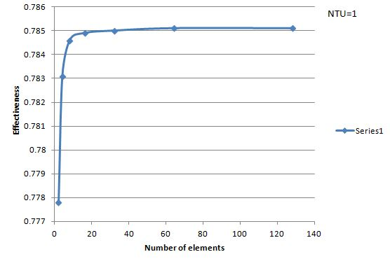
PLOTS- EFFECTIVENESS vs NUMBER OF ELEMENTS

Slide 37
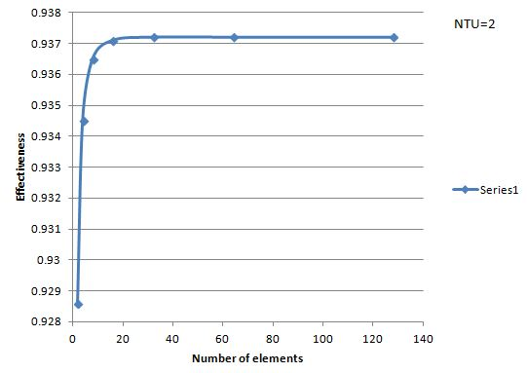
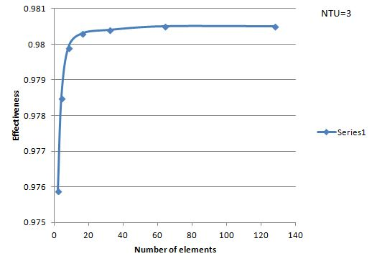

Slide 38
CONVERGENCE TEST FOR A UNIQUE CASE
PROPERTIES OF THE CASE
The dimensionless variables R_{1,} R₂ and h are all assumed zero.
Under the assumption of C_{min}=0, the analytical effectiveness of all heat exchangers is the same and is given by
ϵ = 1- e^{(-NTU)}
Using this formula for analytical effectiveness in the MATLAB code to test convergence of Finite Element solutions.
Similar to the previous tests, the number of elements is varied at different NTU values. Analytical effectiveness and effectiveness from Finite Element method is compared.

Slide 39
RESULTS TABLE
Number of elements
NTU | Analytical Value | 2e | 4e | 8e | 16e | 32e | 64e | 128e
0.5 | 0.3935 | 0.3920 | 0.3931 | 0.3934 | 0.3934 | 0.3935 | 0.3935 | 0.3935
1 | 0.6321 | 0.6269 | 0.6307 | 0.6318 | 0.6320 | 0.6321 | 0.6321 | 0.6321
1.5 | 0.7769 | 0.7692 | 0.7747 | 0.7763 | 0.7767 | 0.7768 | 0.7769 | 0.7769
2 | 0.8647 | 0.8571 | 0.8622 | 0.8640 | 0.8645 | 0.8646 | 0.8647 | 0.8647
2.5 | 0.9179 | 0.9123 | 0.9157 | 0.9173 | 0.9178 | 0.9179 | 0.9179 | 0.9179
3 | 0.9502 | 0.9474 | 0.9484 | 0.9497 | 0.9501 | 0.9502 | 0.9502 | 0.9502

Slide 40
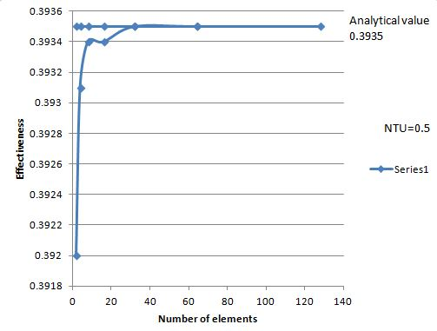
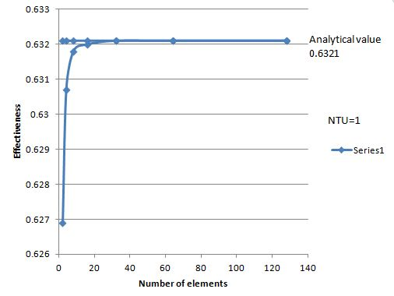
PLOTS- EFFECTIVENESS vs NUMBER OF ELEMENTS

Slide 41
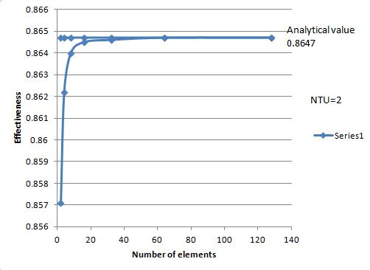
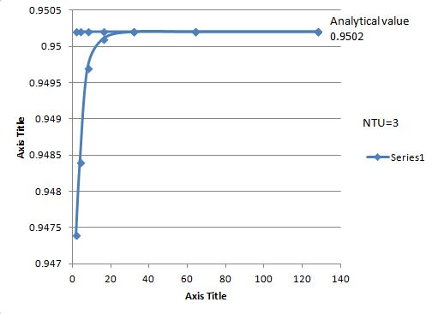

Slide 42
CONCLUSIONS
1. In literature survey, we found that the Sub-Domain collocation method was more accurate than Galerkin’s method. We were able to provide enough information to support the above observation.
2. Finite element methods can be used to analyze heat exchangers. The process is cumbersome but when coded in MATLAB, the solution is simplified.
3. The sub-domain collocation method and Galerkin's method are both efficient method for analysis. But the convergence of solution is observed at lesser number of elements in Sub-domain collocation method as compared to Galerkin's method. Based on this observation, sub-domain collocation method was used to analyze three-fluid heat exchanger.

Slide 43
4. For same operating conditions, the effectiveness of three-fluid heat exchanger was more than that for a two fluid heat exchanger.
5. There is no exact formula for analytical effectiveness of three fluid heat exchangers as the heat exchanges are complex to analyze.
6. The complexity of solution for three fluid heat exchanger is higher than two fluid heat exchanger. Hence more number of elements was required to observe convergence of solution.
7. From the case study, we can confirm the MATLAB code for three fluid is satisfactory.

Slide 44
THANK YOU

